Slide 1
The Theater
Plays produced for the general public
Roofless>open air
No artificial lighting
Courtyard surrounded by 3 levels of galleries

Slide 2
Spectators
Wealthy got benches
“Groundlings”>poorer people stood and watched from the courtyard (“pit”)
All but wealthy were uneducated/illiterate
Much more interaction than today

Slide 3
Staging Areas
Stage>platform that extended into the pit
Dressing & storage rooms in galleries behind & above stage
second-level gallery> upper stage> famous balcony scene in R & J
Trap door>ghosts
“Heavens”> angelic beings

Slide 4
Differences
No scenery
Settings > references in dialogue
Elaborate costumes
Plenty of props
Fast-paced, colorful>2 hours!

Slide 5
Actors
Only men and boys
Young boys whose voices had not changed play women’s roles
Would have been considered indecent for a woman to appear on stage

Slide 7
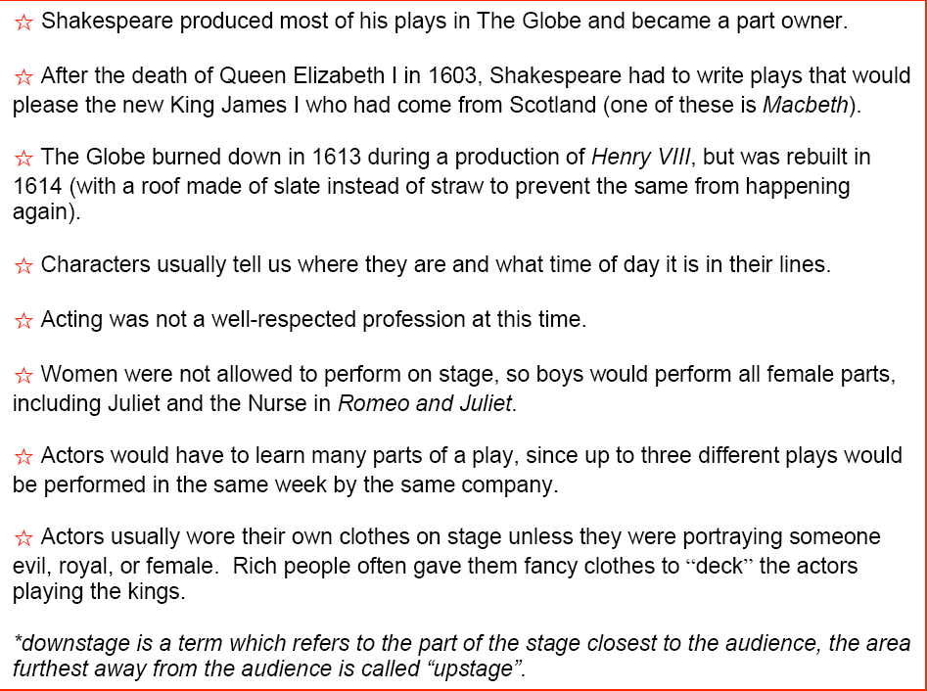
Elizabethan Theatre

